Slide 1
Policy Brands Roundtable - Annual Brand Strength Update
Summer 2015
Initial release

Slide 2





Quantitative Research Model Overview
Measuring Influence Inside the Beltway
The Policy Brands Roundtable is a strategic research service designed to support policy executives seeking to assess and enhance their approach to advocacy. The research answers two critical questions: 1) How do decision-makers perceive an organization’s work in Washington? and 2) What activities do policy influentials care about most?
The first question is answered by collecting feedback on four measures—respect, consideration, influence and sharing. A weighted average of these measures captures the strength of an organization’s policy brand in a single metric. The second question is addressed via feedback on 12 policy brand “drivers,” actions or behaviors impacting an organization’s level of influence among Washington opinion leaders.
Q: How do Decision-makers perceive YOUR work in Washington?
RESPECT
Do you largely have respect for the organization’s role in the public debate?
Policy Brand Index Score
CONSIDERATION
Policy Brand Index
Measures Of Policy Brand
Do you genuinely consider the organization’s positions on issues?
INFLUENCE
Would the organization’s views influence your views favorably?
SHARING
Would you seek out or share the organization’s opinion on an issue?
Q: What Actions do Washington influentials care most about?
 | Organizational Visibility |  |  |  | External Engagement |  |  |  | Corporate Citizenship
 | C-Suite Engagement Lobbying Representation Media Profile |  |  |  | Coalition-Building Bipartisan Collaboration Grassroots |  |  |  | Corporate Social Responsibility Ethics
 |  |  | Subject-Matter Contribution |  |  |  | Policy Positioning
 |  |  | Constructive Arguments Research |  |  |  | Compromise Relevance
Policy Brand Drivers by Category

Slide 3
Survey Development
Round 2
Round 3
Round 4
Round 1
Q4
2011
Q1
2012
Q2
2012
Q3
2012
Q1
2013
Q3
2011
Q2
2013
Q4
2012
Q3
2013
Q4
2013
Q1
2014
Q2
2014
Q3
2014
Test Survey 1
Analytical Tools
Research Interviews 1
Bivariate correlation analysis
OLS regression
Multivariate linear regression
Principal component (factor) analysis
Qualitative research interviews
Split testing
Student’s t-test
Research Interviews 2
Test Survey 2
Test Survey 3
Test Survey 4
Test Survey 5
Launch
Process Detail
Q3 2011: Tested the perception of organizations’ policy brand among policy influentials. Survey tested 4 metrics that measure policy brand. Developed a list of 200 characteristics that impact the influence of a policy brand.
Q4 2011–Q1 2012: Conducted 240 research interviews that confirmed the impact of 180 of the 200 organizational characteristics that drive influence.
Q2–Q3 2012: Conducted another set of 100 research interviews to refine the list of 180 characteristics to 120.
Q4 2012: Conducted a test survey of 150 policy influentials to refine the list of 120 characteristics to 50.
Q1 2013: Conducted a test survey of 400 policy influentials that refined the list of 50 characteristics to 30 characteristics.
Q2 2013: Conducted a test survey of 100 policy influentials that refined the list of 30 characteristics to 16.
Q3 2013: Launched inaugural survey with 4 metrics that measure policy brand and the 16 characteristics of a policy brand that drive this influence.
Q3 2014: Revised survey to feature the 12 characteristics that drive policy brand influence.

Slide 4



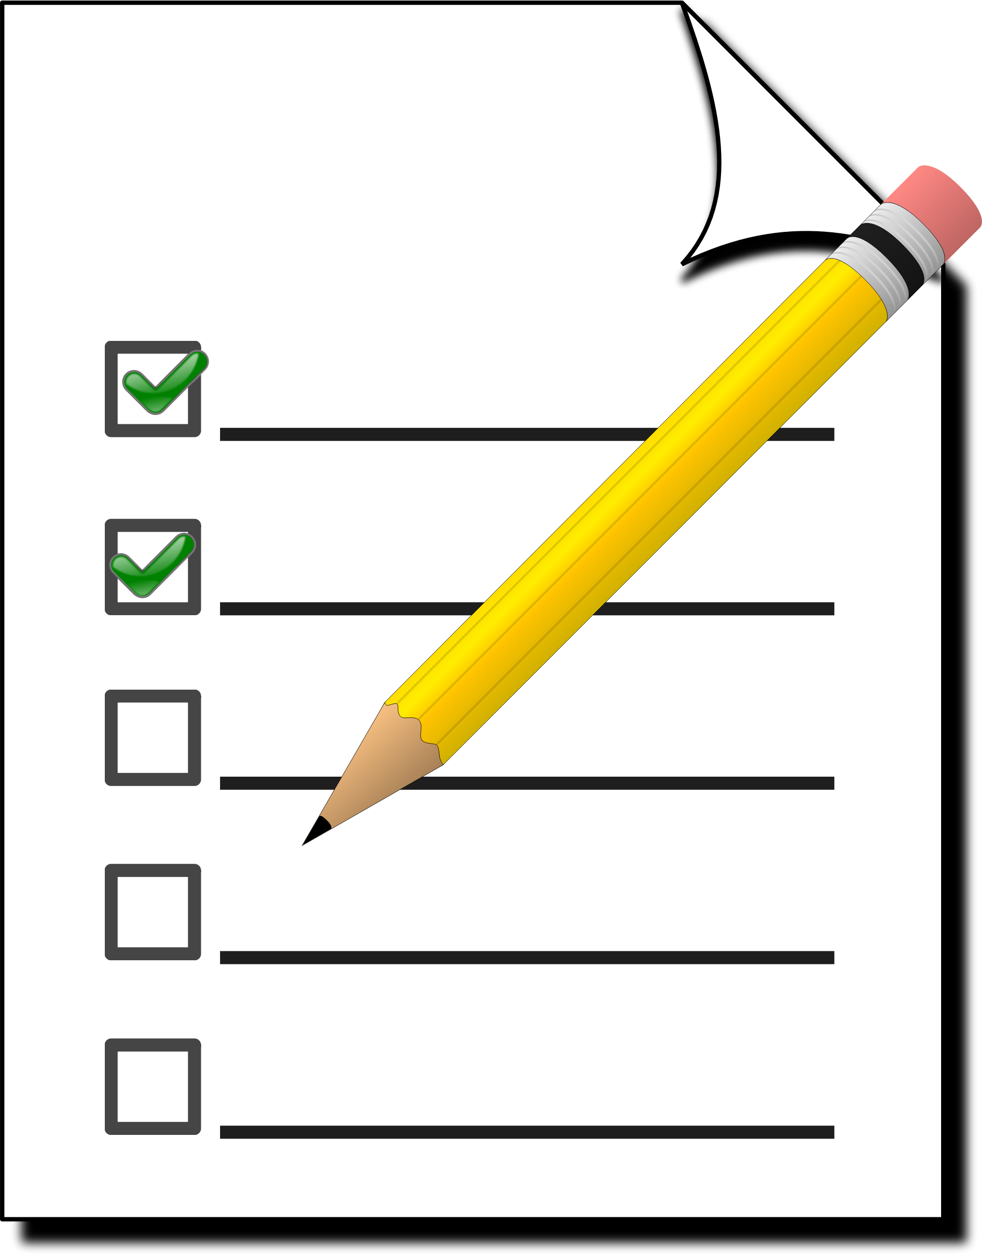

Overall Familiarity with Advocacy Work in Washington
Using Familiarity to Qualify Respondents
Before evaluating organizations on policy brand-related measures, survey participants first rate their familiarity with an organization’s advocacy work in Washington. Responses are captured on a five-point scale from “not familiar” to “very familiar.” Only those individuals indicating that they were “somewhat familiar” to “very familiar” with your advocacy efforts (i.e., rating a 3-5 on familiarity) were allowed to evaluate your organization’s policy brand.
Drilling Down To The Experts That Know Your Brand
Yes, Eligible to Evaluate Organization
Are you familiar with AlphaCo's advocacy efforts in Washington?
Familiar
Not Familiar
No, Ineligible to Evaluate Organization
Average Corporation
AlphaCo
Average Corporation
Not Familiar With Work in Washington
Familiar With Work in Washington
Not Familiar With Work in Washington
Familiar With Work in Washington
Source: Policy Brands Roundtable survey and analysis. Data reference available in Section 4 Data Appendix.

Slide 5




Research Timeline
Annual Assessment and Priority Mapping
Internal assessment of your strategic priorities to inform the year’s research agenda.
(Winter/Spring 2015)
Quantitative
Update
Presentation of the custom data-driven insights and findings from the quantitative survey.
(July 2015)
Follow-Up Analysis and Presentations
Further analyses of data of interest for your organization and stakeholder groups.
(July-November 2015)
Qualitative Research Period
In-depth qualitative feedback collected from Washington influentials on your behalf.
(August-November 2015)
Annual Summative Report Delivery
Final presentation of qualitative research and overall takeaways on your policy brand.
(December 2015)
Quantitative Research Process
April - June Capitol Hill Executive Branch Policy Professionals
National Journal Research deployed an extensive survey from April to June 2015 to quantitatively assess the strength of your “policy brand”; survey data provides an opportunity to quantify and test a set of hypotheses around the makings of a strong Washington office.
The most recent Policy Brands Roundtable survey collected data on 100 organizations from over 1,300 individuals in the Washington policy community. This report benchmarks your organization's scores on a variety of measures to those of relevant comparison groups.

